Slide 1
Parts Manual Development (PMD) Tools
Tools developed to remove redundancies between Illustrator, Provisioner, and Writer, and to eliminate tedious tasks.

Slide 2
Main Sets of Tools
PMD Tools
Arbortext Tools
PLISN Tools
Part Number Index Tools
Resources (Includes miscellaneous tools and information)

Slide 3
PMD_Tools What can they do?
These tools will take any 036 report from any program and produce an IPB or RPSTL from nothing in less than 20 minutes. (minus illustrations)
The tools will analyze the information in the 036 and breakdown the separation of the indenture codes, calculate how many figures are needed, and write all the appropriate files for SGML and Excel.
The Excel files include communication tools for the illustrator to use, and update, as they develop the illustrations.
From there the SGML files can be updated in less than 5 minutes at any time.
This tool has other abilities that do pieces of this process based on desire.
Tracking using reference number to PLISN is automated and allows for manual manipulation.
At the end of every process you choose, a log is written of what happened during the process. This log includes details of which figures have changed and what all was chosen to accomplish, such as writing or updating SGML files.

Slide 4
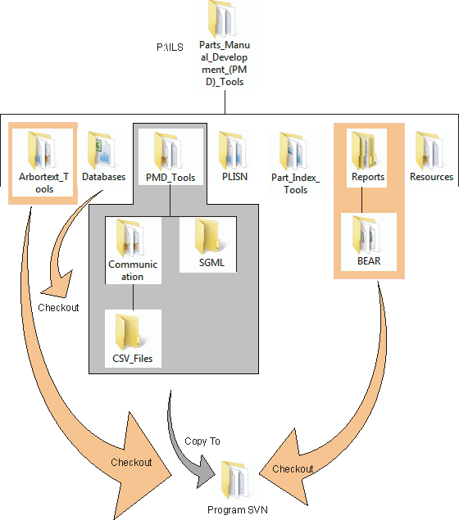
Folder Structure
Copy PMD_Tools from the following location;
P:\ILS\Parts_Manual_Development_(PMD)_Tools\
Paste PMD_Tools to your program's folder, in the desired location for the parts manual information.
Right click and change remove read only checkmark on all.
Add and commit folder.
Perform the following steps for manuals that require SGML tagging;
Checkout the following, if SGML is involved;
https://mother.ils.local/svn/ILS/Parts_Manual_Development_(PMD)_Tools/Arbortext_Tools
https://mother.ils.local/svn/ILS/Parts_Manual_Development_(PMD)_Tools/Cage_Codes
https://mother.ils.local/svn/ILS/Parts_Manual_Development_(PMD)_Tools/Reports
Cut Cage_Codes checkout and paste inside the Arbortext_Tools checkout.
c.) Cut the Arbortext_Tools checkout and paste in into the PMD_Tools folder inside the program folder.
d.) Cut the Reports checkout and paste in into the PMD_Tools folder inside the program folder.
4. The file structure is now ready and from here you may begin the process with the 036_to_Spreadsheet.

Slide 5
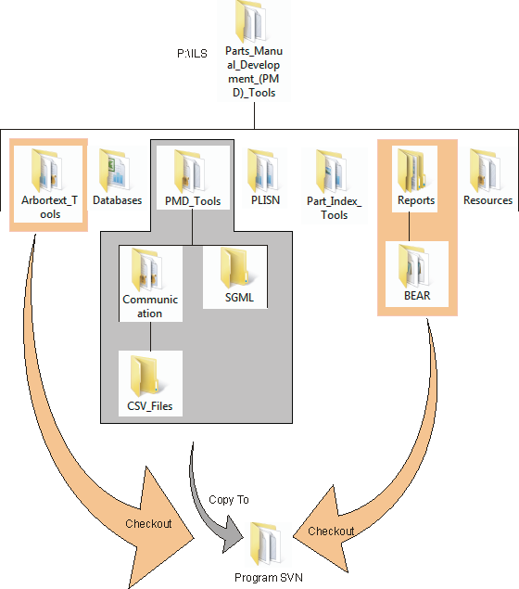
PMD Tools\
PMD Utility
Used to control the tools, with a Userform, and writes a log.
SDFP Calculator
Used to import information from a folder(s) and compare it to the 036 to Spreadsheet Tool, and return differences in naming, missing information, same as PLISNs, move and/or rename files, and provided filterable categories.

Slide 6
Communication\
036 to Spreadsheet - Used to convert 036 to spreadsheet back to 036 report.
Cage Codes for Arbortext are ran from this file.
PMD Filter is linked to this file.
PMD Filter - This file is where you adjust your programs specific conditions.
How many figures is figured out by a set of formulas and may be modified to automatically adjust by modifying formulas in a few columns.
Separation of text and casing is figured out by a set of formulas with input for manipulation on the Digits sheet.
Figure Source - Used to create each figure's communication workbook.
Sheet and not illustrated information is added by the illustrator here.
If csv files are used;
Used to create the csv files for Corel. (PMD Tools\Communication\CSV Files
Used for the illustrator to get the reference number
Future changes may incorporate f-id numbers for Arbortext tagging automation.
PMD Source - Used to consolidate all the communication figures and the PMD Filter.
PMD IPB Template links to this
PMD IPB Template - Used to make an IPB.
Has a section to be copied to Word.
Will write Arbortext files.

Slide 7
Arbortext_Tools What can they do?
This tool can write the outline for the beginnings of a manual with properly formatted references to each file, broken down into sub-folders for batch updating purposes.
The Databases folder is put inside this folder for now, but is subject to change. Currently the only database we have is for the cage codes.

Slide 8
Arbortext Tools\
CAGE Codes
Used to write the tables in Arbortext for Cage Codes in Alpha-Numeric order
IPB Outline Arbortext Development
Used to write an entire outline for an IPB in Arbortext with references to a PMD Tools\SGML\Table Tags folder where the tables will be written.
If Table Tags folder does not exist it will make it.
It will determine the amount of Figures to write based on the PMD Filter or your input.
All files and referencing is written except for Figures.
TO number is required to write the files, or some equivalent variable for unique naming.

Slide 9
Databases\
Cage Codes
Stores all the properly formatted Cage Codes information that the other tools use.

Slide 10
Reports Why here?
The Reports folder is here to access any programs information history, separated by folders named after each program.

Slide 11
Reports\
There are no tools here, just Program folders with reports in them.
Each program has a folder and is checked out together for resource purposes.
Each unique file inside, 036 or PTD, is named the PCCN of the program.
Other duplicate file types will have definition added to name following the PCCN.

Slide 12
PLISN_Tools What can they do?
They can start, add, edit, and update PLISNs, and compare LCN indentures.

Slide 13
PLISN\
Universal PLISN'er
Will calculate PLISN gaps or initial PLISN'ing for you with input for gap and some possible error detection.
PLISN to LCN indenture compare
Compares the indenture level copied from PowerLog for the LCNs and the PLISNs.

Slide 14
Part_Number_Index_Tools What can they do?
Developed to sort part numbers Alpha-Numerically, and then put in single or double columns.

Slide 15
Part_Index_Tools\
Alphanumeric Sort – Cascade and Left to Right
Sorts items in to different alpha numeric methods
PN-NSN Table Splitter
Splits up a table with two columns after sorting
PN Index-Double Columns
Page setup is set for double columns
PN Index
Page setup is set for a table with two columns but single column page

Slide 16
Resources What is in here?
Miscellaneous tools and information related to provisioning and other tools without a home.

Slide 17
Resources\
036 Place Definitions
Gives the definition of each place in an 036 report.
SMR calculator
Will walk you through a set of questions and tell you the SMR code.
LCN Initial Calculator
Paste indenture in the 1st column and it will calculate the LCNs based on the structure you input in the 2nd row and the gap indicated in the first row.
Tables in Powerlog
Gives you multiple ways of looking at powerlog tables and the information.
Fileanator
This tool will batch convert any text base file and rename or move any file from a folder or sub-folders to any folder or subfolders. It can also append all files to a single file.

